Slide 1
Digital Portfolio
STUDENT NAME: NANDHINI K
REGISTER NO AND NMID: 2426J1528 AND asbruaz2426j1528
DEPARTMENT: BSC IT
COLLEGE: KPR COLLEGE OF ARTS SCIENCE AND RESEARCH /BHARATHIAR UNIVERSITY

Slide 2
PROJECT TITLE:PHOTOGRAPHY PORTFOLIO

Slide 3


AGENDA
Problem Statement
Project Overview
End Users
Tools and Technologies
Portfolio design and Layout
Features and Functionality
Results and Screenshots
Conclusion
Github Link
3/21/2024 Annual Review

Slide 4

PROBLEM STATEMENT:
Many photographers struggle to showcase their work professionally. Social media platforms limit creativity, while clients prefer a dedicated, well-structured portfolio that highlights skills, style, and versatility.

Slide 5

PROJECT OVERVIEW
This project is about creating a digital photography portfolio where photographers can display their best work, categorized by themes such as portraits, landscapes, events, and creative projects. It allows easy navigation, professional presentation, and accessibility for clients.

Slide 6

WHO ARE THE END USERS?
Professional photographers
Freelance photographers
Students of photography
Clients looking for photography services
Photography enthusiasts

Slide 7

TOOLS AND TECHNIQUES
Frontend: HTML, CSS, JavaScript
Design tools: Adobe Photoshop, Lightroom, Canva
Backend (optional): PHP / Node.js
Hosting: GitHub Pages / Netlify
Photography tools: DSLR/Smartphone Camera, Editing Software

Slide 8
POTFOLIO DESIGN AND LAYOUT
Homepage with introduction and profile picture
Gallery section with categorized albums (Portraits, Nature, Events, Creative Shots, etc.)
About Me page (skills, experience, certifications)
Contact page with email/social media links
Responsive design (mobile-friendly)
8

Slide 9
FEATURES AND FUNCTIONALITY
High-quality image display with lightbox view
Categorized gallery for better navigation
Download/Share option for selected images
Contact form integration
Interactive and aesthetic UI/UX

Slide 10
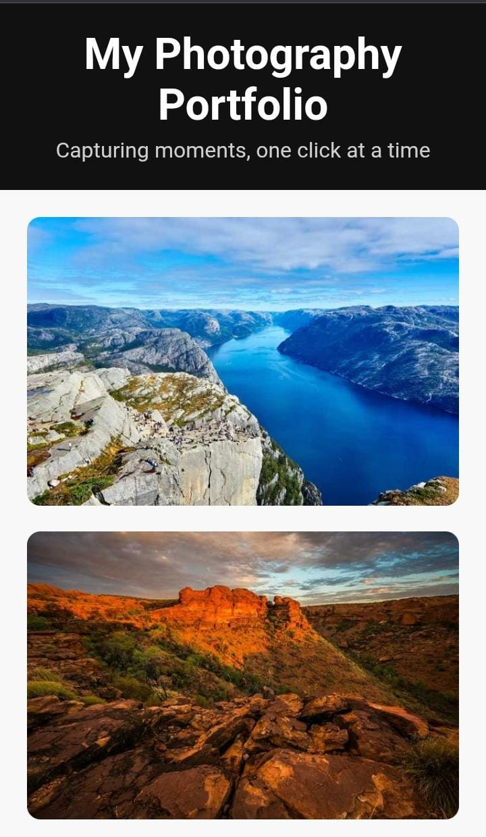
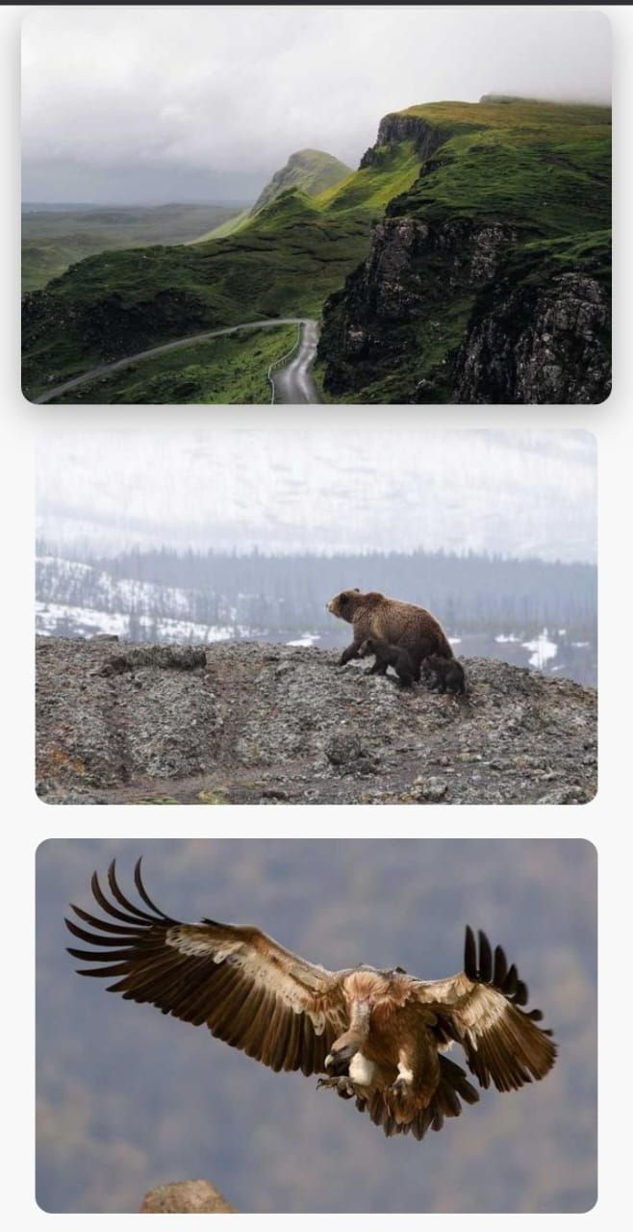
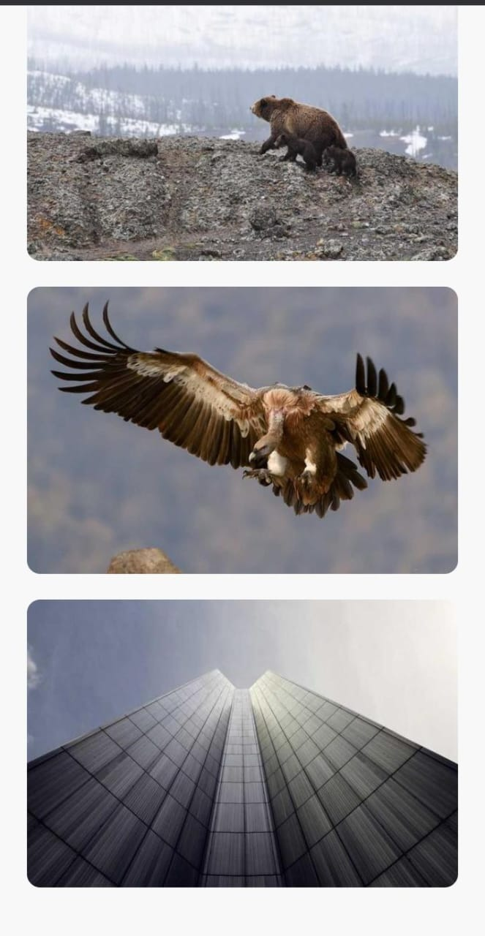

RESULTS AND SCREENSHOTS
3/21/2024 Annual Review
10

Slide 11
CONCLUSION
The Photography Portfolio project provides an elegant and professional way for photographers to showcase their creativity. It enhances personal branding, increases client reach, and builds a strong online presence.
11

